Slide 1
Windows Privilege Escalation
A Pentester's Methodology to Discover and Exploit flaws on the network
Also useful if you are planning to do OSCP ☺

Slide 2
Riyaz Walikar
@riyazwalikar | @wincmdfu
Chief Offensive Security Officer at Appsecco
http://ibreak.software
OWASP Bangalore chapter leader, null Bangalore leader
Trainer/Speaker: BlackHat Asia, BlackHat USA, nullcon Goa, nullcon Delhi, c0c0n, OWASP AppSec USA

Slide 3
This talk is not about
Kernel level exploits
Race conditions
Heap/stack any form of overflows
A pentester’s approach on a network
jibber jabber from experience
Real world examples
Design issues, misconfigurations, binary planting, permission issues, forensics, hash passing/spraying etc.

Slide 4
Limited privileges already obtained on the machine/network via pentest, valid auth etc. C:\> runas /user:account cmd.exe

Slide 5
Administrator to System is trivial
psexec -s -i -d cmd.exe
C:\> at /interactive 14:50 cmd.exe (schtasks in Win 7 and higher)

Slide 6
Try this out
Open regedit
Navigate to HKLM\Software\Microsoft\Windows NT\CurrentVersion\Image File Execution Options\
Create a new key and name it sethc.exe
Create a new String value in the right pane and name it Debugger
Change its data to cmd.exe
Lock your screen and press Shift 5 times
In the cmd that opens, execute whoami /priv

Slide 7
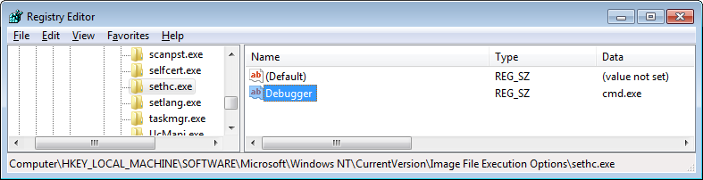
Try this out
Lock your screen and press Shift 5 times
In the cmd that opens, execute whoami /priv

Slide 8

Demo

Slide 9
Limited user to Administrator/SYSTEM Local Admin to Domain Admin

Slide 10
Abusing Scheduled Tasks

Slide 11
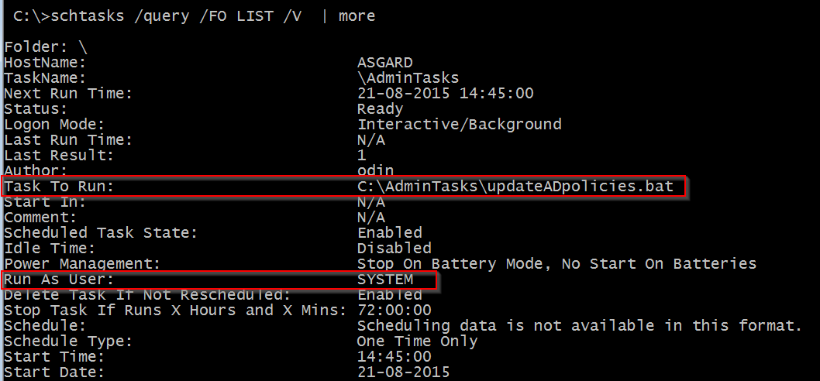
C:\> schtasks /query /fo LIST /v

Slide 12
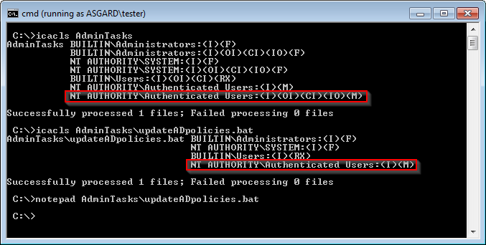
C:\> icacls C:\AdminTasks\

Slide 13
Passwords in files/registry
[unencrypted (like for real!)]

Slide 14


Slide 15
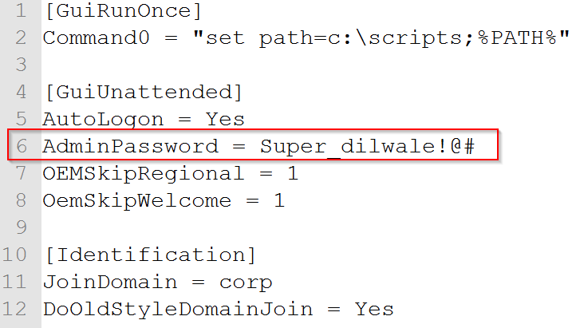
c:\sysprep.inf

Slide 16
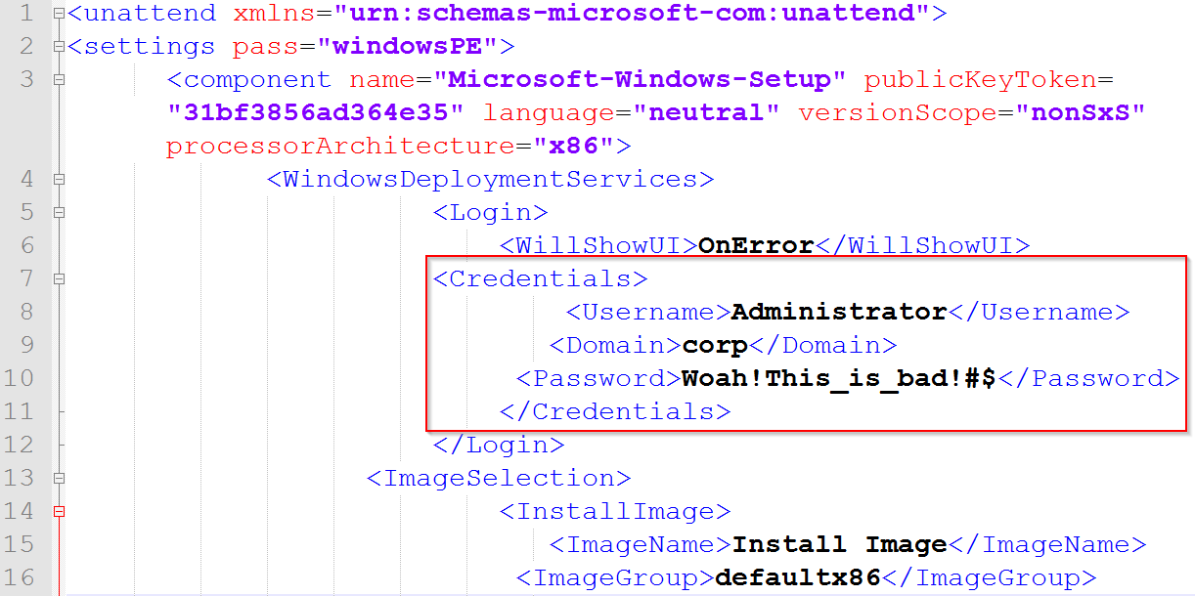
c:\sysprep\sysprep.xml

Slide 17
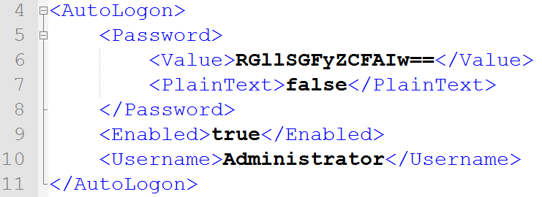
unattended.xml

Slide 18
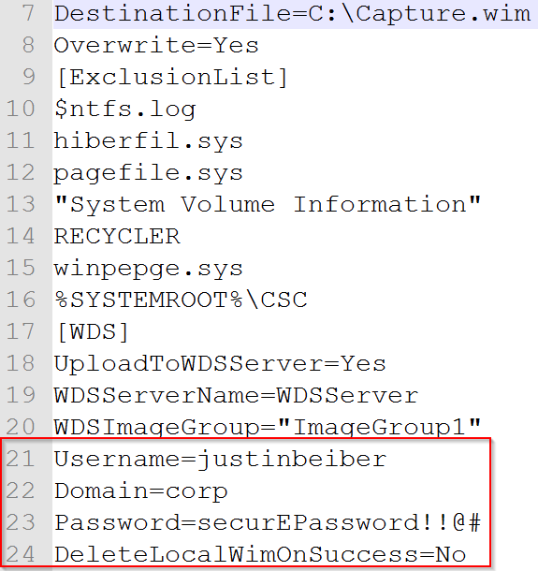
wdscapture.inf
https://technet.microsoft.com/en-us/library/cc732280(v=ws.10).aspx

Slide 19
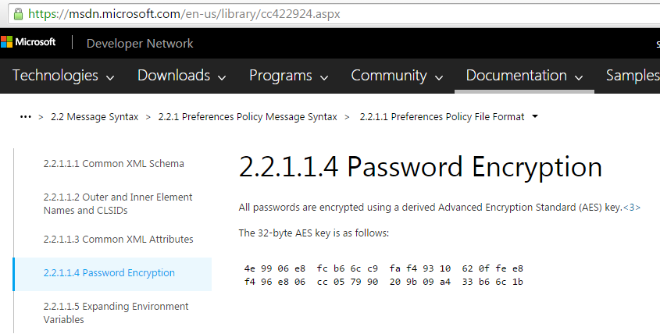
Groups.xml in sysvol

Slide 20
*vnc
RealVNC [HKEY_LOCAL_MACHINE\SOFTWARE\RealVNC\vncserver]
TightVNC [HKEY_CURRENT_USER\Software\TightVNC\Server]
TigerVNC [HKEY_LOCAL_USER\Software\TigerVNC\WinVNC4]
UltraVNC [C:\Program Files\UltraVNC\ultravnc.ini]

Slide 21
Other places / software
Autologon [HKLM\Software\Microsoft\Windows NT\CurrentVersion\Winlogon]
HKEY_CURRENT_USER\Software\SimonTatham\PuTTY\Sessions
Search the OS using dir /s and findstr /S /I (.xlsx, .docx, .pdf etc.)
Search the Windows registry using reg query

Slide 22
Forensics and Data carving

Slide 23
Disk Image data
Search for *.vmdk, *.vdi, *.vhd, *.qed
Vmware, Virtual and Virtual PC disk images
ISO files, Ghost images, Daemon tool images etc.
Memory snapshopts (*.vmem files for example)

Slide 24
Demo

Slide 25
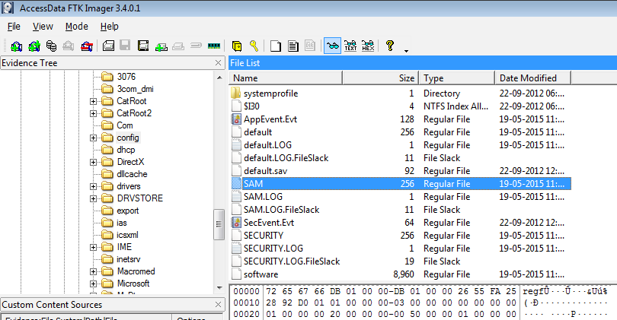

Slide 26
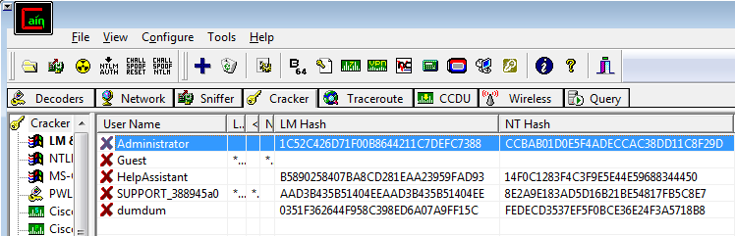

Slide 27
I came, I saw, I passed the hash
use exploit/windows/smb/psexec
Windows Credential Editor + net use + sysinternals psexec
Windows Credential Editor + net use + wmiexec.py (Impacket)
Good way to identify if the user is local admin on any other machine
LocalAccountTokenFilterPolicy set to 1 to allow PTH

Slide 28
Abusing Service (mis)configurations

Slide 29
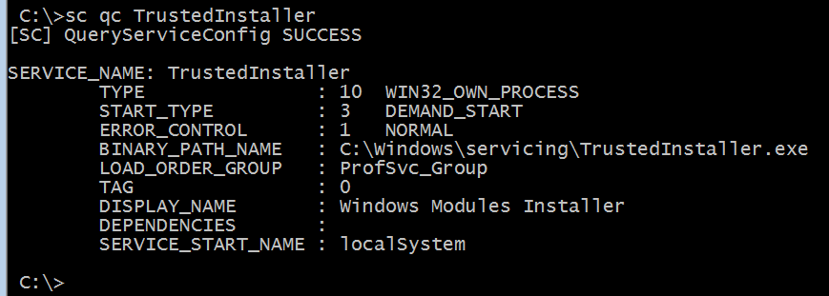
Service permission issues
C:\> sc qc <servicename>

Slide 30
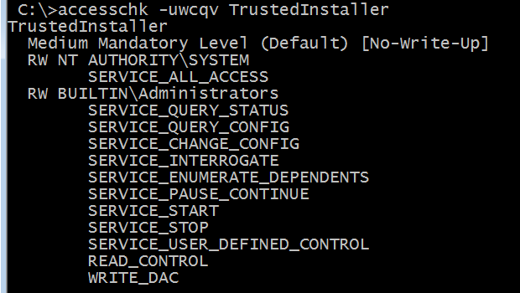
Service permission issues
C:\accesschk -cqwvu <servicename> | *

Slide 31
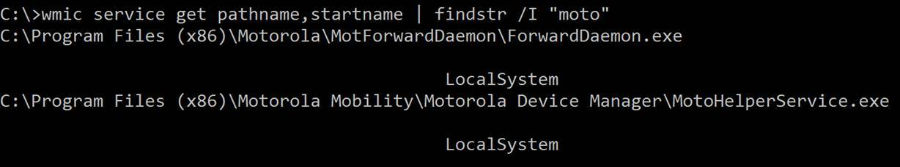
Unquoted paths
wmic service get pathname,startname | findstr /I "moto"

Slide 32
Window Messaging

Slide 33
Message Passing
Passing a message via SendMessage to the message loop of the main thread of the program
Shatter attack allowed cross process message passing between unprivileged process and a privileged thread.
Can be used to pass a message to a windowed system object running on a thread as NT Authority\SYSTEM
CB_DIR, LB_DIR etc.

Slide 34
Demo

Slide 35
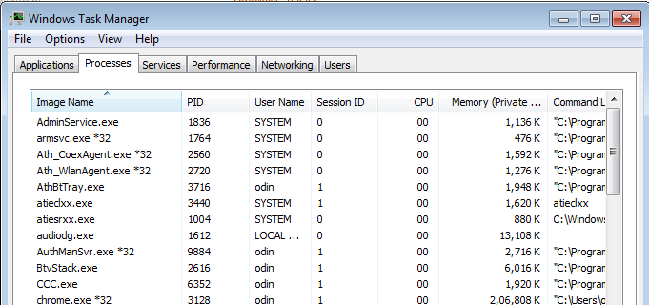
Session separation!
Notes:
Check using PokeWindows

Slide 36
Binary Planting

Slide 37
Abusing load paths
A binary can call code from external link libraries (DLLs)
Static Runtime loading
Dynamic loading using kernel32.LoadLibraryA()
Both can be abused because the path is (most likely) user controlled

Slide 38
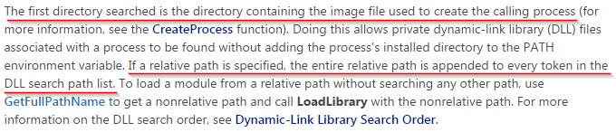

Slide 39
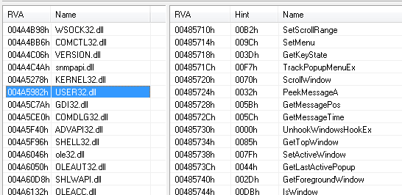
Static Linking (bginfo.exe)

Slide 40
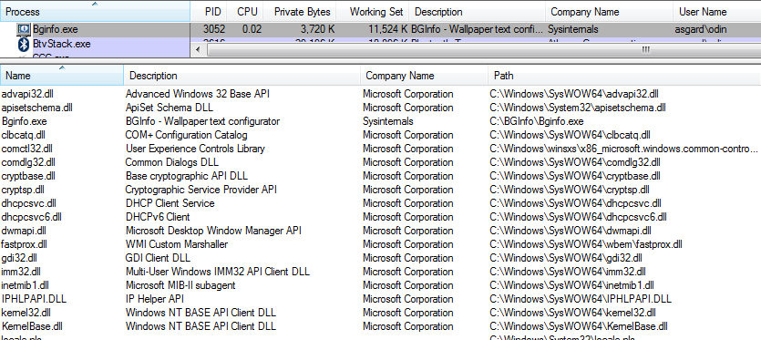
Dynamic Linking (bginfo.exe)
Notes:
Not exhaustive. Will not know entire list till program is decompiled and all LoadLibraryA() calls are traced. Loadlibrary may exist in uncalled functions.

Slide 41
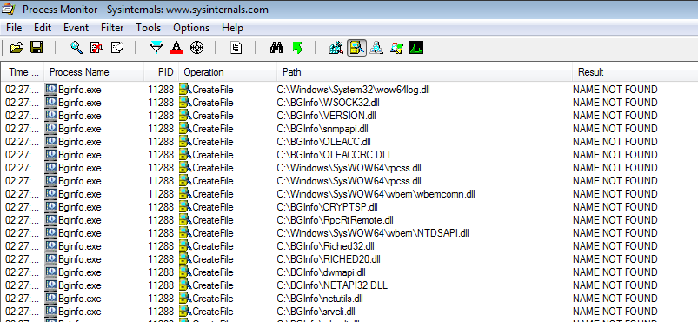
Weak directory permissions
Notes:
Not exhaustive. Will not know entire list till program is decompiled and all LoadLibraryA() calls are traced. Loadlibrary may exist in uncalled functions.

Slide 42
Demo

Slide 43
Delayed/Selective Patching

Slide 44
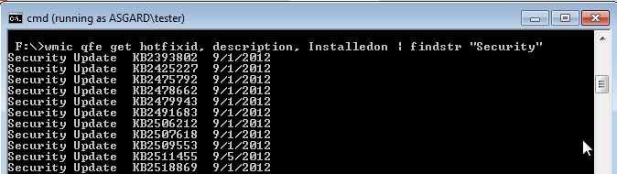
Several exploits available
wmic qfe get hotfixid, description, Installedon | findstr “Security”

Slide 45
To Summarize
1. Enumerate installed programs. This is to identify programs that can store passwords locally. A lot of programs store passwords in world readable files or in the Windows registry. And administrators re-use passwords. Installed programs also tell you if there is an older vulnerable version of a program that is running with higher privileges that you can exploit. Also anything outside the "C:\Program Files" should be a good case to investigate.
2. Enumerate services that run with SYSTEM/Admin privs. Check if any of these services have a path configured without double quotes. This can be used to perform a unquoted service name attack.
3. Check if any service running with SYSTEM/Admin privs is configured with weak permissions (use accesschk.exe) that would allow you to stop, reconfigure, point to your own binary, start. Your binary should simply create a new admin user.

Slide 46
To Summarize
4. Look at startup programs/scripts that are in locations were a limited user has write permissions. You can edit scripts or replace shortcut files with your own data to get a higher privileged account to run your code. Autorunsc from sysinternals is a good tool to list startup stuff. Autorunsc is the command-line version of Autoruns.
5. Look for passwords in files. These could be text files, MS Office documents, configuration files, setup files, Windows unattended installation files. I even look at the MySQL my.ini file to find the "datadir" variable which tells me the location of the MySQL database files. I then find the MySQL user table and extract the hash of the MySQL root user, crack it using hashcat and obtain the plain text. This allows us to either attempt to reuse the password with Windows login or connect to MySQL as a root user and perform a UDF attack if the MySQL service is running as SYSTEM. A lot of programs that may run with admin privileges store passwords in reversible format on disk or apply some form of encryption which hashcat or john should be able to crack.

Slide 47
To Summarize
6. Apart from the disk, look for passwords in the Windows registry. Look at the HKLM winlogon key (for auto logon user and password) and the keys for SimonTatham putty sessions, RDP, VNC, FileZilla etc. Also look at the C:\Windows\system32\Config for hive backups and the C:\Windows\Repair folder to find backup copies of the SAM, SECURITY and SYSTEM files. You can then simply use sampdump2 or the secretsdump.py from Impacket tools to dump hashes and replay/crack them from there.
7. There are times when there is a process that has a port open but only listening on the localhost. You might then want to port forward using netsh or a Windows socat binary and connect to the privileged service. Filezilla's admin service is a good example of this.

Slide 48
To Summarize
8. Look out for web ports that are running of custom web servers or have been setup with admin rights. A file (shell) upload, directory browsing to reach C:\Windows\Repair or a server side code execution would mean privilege escalation.
9. A lot of programs have CVE's assigned to them (especially Antivirus software) that I can use to run privileged code. Google helps here. The bugs could be a simple DLL preloading/binary planting attack or a buffer overflow using a malicious file etc.
10. Most importantly, look at the Operating System, hotfixes, patch levels. You can use the mingw setup to cross compile exploits on Linux for Windows. More often than not, the privilege escalation is because of a missing patch.

Slide 49
Resources
http://pentestmonkey.net/tools/windows-privesc-check
http://www.fuzzysecurity.com/tutorials/16.html
https://msdn.microsoft.com/en-us/library/cc422924.aspx
https://www.harmj0y.net/blog/redteaming/pass-the-hash-is-dead-long-live-localaccounttokenfilterpolicy/
https://ibreak.software
Sysinternals FTW

Slide 50
Questions and Answers
Riyaz Walikar
@riyazwalikar | @wincmdfu
http://ibreak.software

